Slide 1
Project Management
Instructor: Mehroze Khan

Slide 2
Project Planning
Before starting
Establish system’s scope and objectives
Consider alternative solutions
Identify technical and management constraints
As a Project Manager
Decompose the product function (FD)
Select an appropriate process model
Select the task set for the project
Decompose the tasks into smaller work items (WBS)
Estimate effort for each task/work item
Estimate completion time of the project (Task/Activity Network)

Slide 3
Task Set
A task set is a collection of software engineering work tasks, milestones, work products, and quality assurance filters that must be accomplished to complete a particular project.
To develop a project schedule, a task set must be distributed on the project timeline.

Slide 4
Factors Affecting Choice of Task Set
Size of project
Number of potential users
Mission criticality
Application longevity
Stability of requirements
Ease of communication (customer/developer)
Maturity of applicable technology
Performance constraints
Embedded/Non-Embedded characteristics of project
Project Staff
Reengineering factors

Slide 5
WBS and Activity Networks
Work breakdown structure depicts the project as a set of discrete pieces of work
Activity networks (task network, PERT [program evaluation and review technique] charts) depict the dependencies among activities
Activity networks can be of two types:
Activity on Arc
Activity on Node

Slide 6
Project Types
Concept Development
To explore new business concept
New Application Development
As a consequence of specific customer request
Application Enhancement
Modifications to existing functions, performance, interfaces of software; observable by the end user
Application Maintenance
Correct, adapt, extend existing software; not immediately obvious to end user
Reengineering Projects
Redevelop an existing system

Slide 7
Concept Development Projects (CDP)
Usually initiated to explore some new business concept or application of some new technology
Task set might be like:
1.1 Concept scoping determines the overall scope of the project.
1.2 Preliminary concept planning establishes the organization’s ability to undertake
the work implied by the project scope.
1.3 Technology risk assessment evaluates the risk associated with the technology
to be implemented as part of the project scope.
1.4 Proof of concept demonstrates the viability of a new technology in the software
context.
1.5 Concept implementation implements the concept representation in a manner
that can be reviewed by a customer and is used for “marketing” purposes
when a concept must be sold to other customers or management.
1.6 Customer reaction to the concept solicits feedback on a new technology concept
and targets specific customer applications.

Slide 8
Refinement of Major Tasks
Macroscopic schedule must be refined to create a detailed project schedule.
Refinement begins by taking each major task and decomposing it into a set of subtasks (with related work products and milestones).

Slide 9
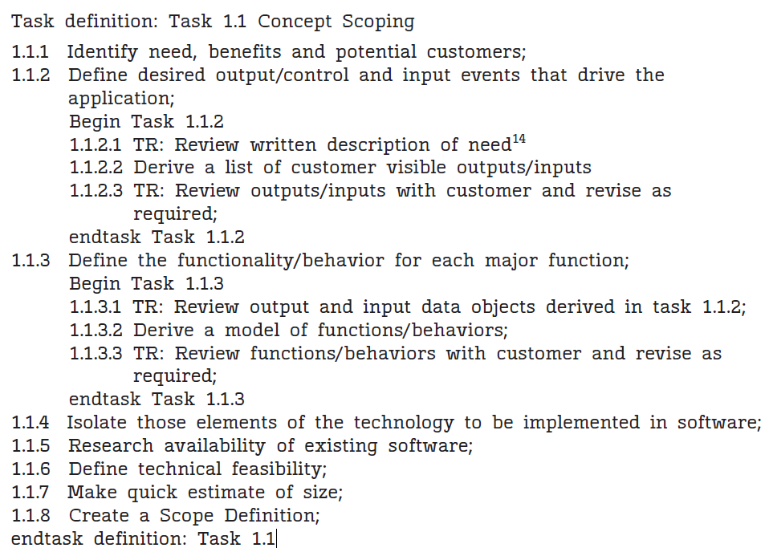
Refinement of Major Tasks (WBS of CDP)

Slide 10
Activity Network
A task network, also called an activity network, is a graphic representation of the task flow for a project.
The task network is a useful mechanism for depicting inter task dependencies and determining the critical path.

Slide 11
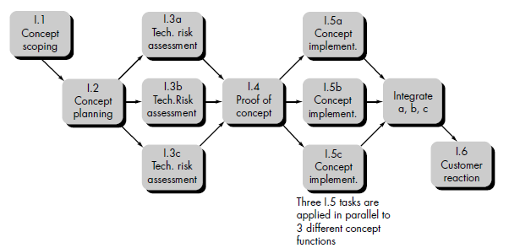
Activity Network of CDP
5
13
8
3
10
15
5
5
10
7
10
Activity on Node (AoN) Graph

Slide 12
Critical Path Method
Estimating Completion Critical Path Method
Analyzing the paths among the milestones of a project is called the Critical Path Method (CPM).
The paths can show us the minimum amount of time it will take to complete the project, given our estimates of each activity’s duration.
CPM reveals those activities that are most critical to completing the project on time.

Slide 13
Estimating Completion Critical Path Method
The real time or actual time for an activity is the estimated amount of time required for the activity to be completed.
The available time is the amount of time available in the schedule for the activity’s completion.
Slack time or float for an activity is the difference between the available time and the real time for that activity:
Slack time = available time - real time
Another way of looking at slack time is to compare the earliest time an activity may begin with the latest time the activity may begin without delaying the project.
Slack time = latest start time - earliest start time

Slide 14
Estimating Completion Critical Path Method
The path that determines whether or not the project is on schedule. is called the critical path.
Thus, the critical path is the one for which the slack at every node is zero.

Slide 15
Estimating Completion Critical Path Method
Critical path: the slack at every activity is zero
can be more than one in a project schedule
Slack time =
available time – real time
latest start time – earliest start time
Paths????
Longest Path???

Slide 16
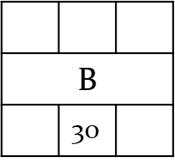
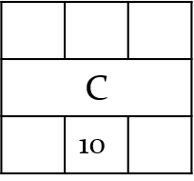
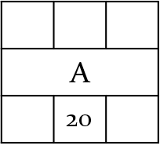
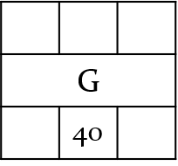
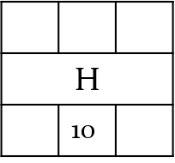
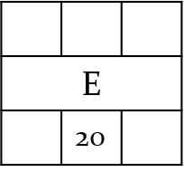
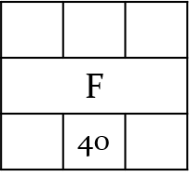
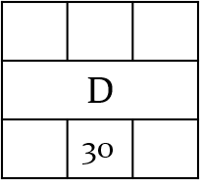
Exercise
Activity | Predecessor | Duration (Days)
A | - | 20
B | A | 30
C | B, H | 10
D | A | 30
E | H | 20
F | C, D, E | 40
G | A | 40
H | G | 10

Slide 17
Exercise
ES | ST | EF
Activity
LS | Dur | LF

Slide 18
Exercise
20
30
50
70
10
80
50
80
80
90
0
0
20
20
0
60
60
0
70
70
0
90
90
0
130
0
20
20
60
60
70
70
90
90
130
20
40
50
60
90
Critical Path: A -> G -> H -> E -> F

Slide 19
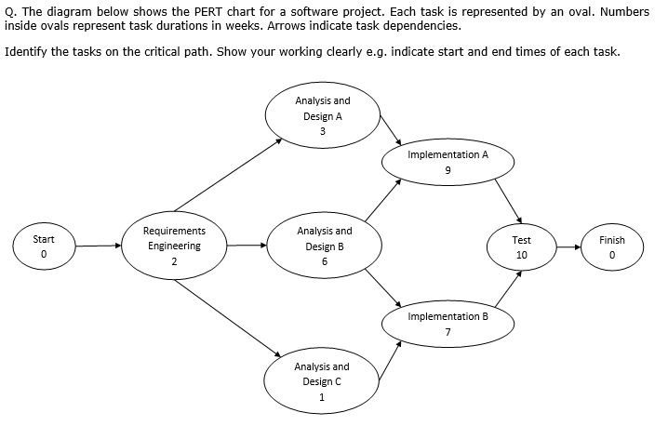
Exercise

Slide 20
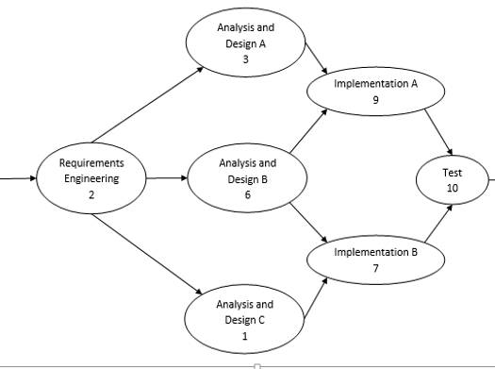
Exercise

Slide 21
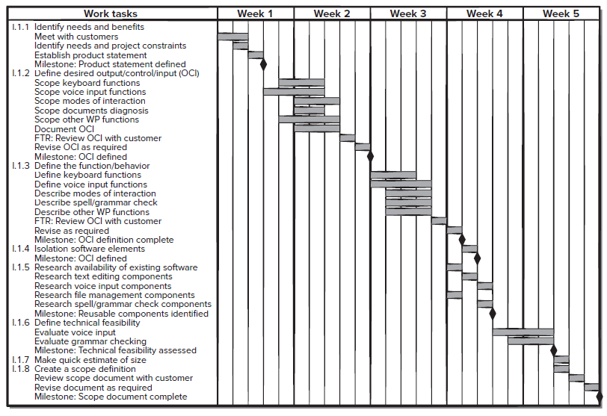
Timeline/Gantt Charts

Slide 22
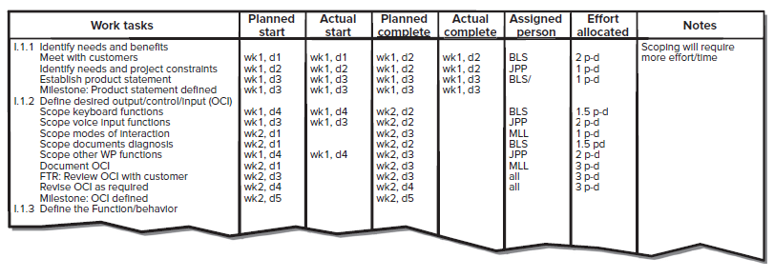
Project Table

Slide 23
References
Shari PFleeger, Joanne Atlee, Software Engineering: Theory and Practice, 4th Edition
Roger S. Pressman, Software Engineering A Practitioner’s Approach, 9th Edition. McGrawHill

